Slide 1
Idea/Approach Details Ministry/ Organization name: GAIL Problem Statement : Blockchain Powered Procurement System for GAIL (BK225) Team Name : Vision Team Leader Name : Abhishek Vispute College Code :

Slide 2
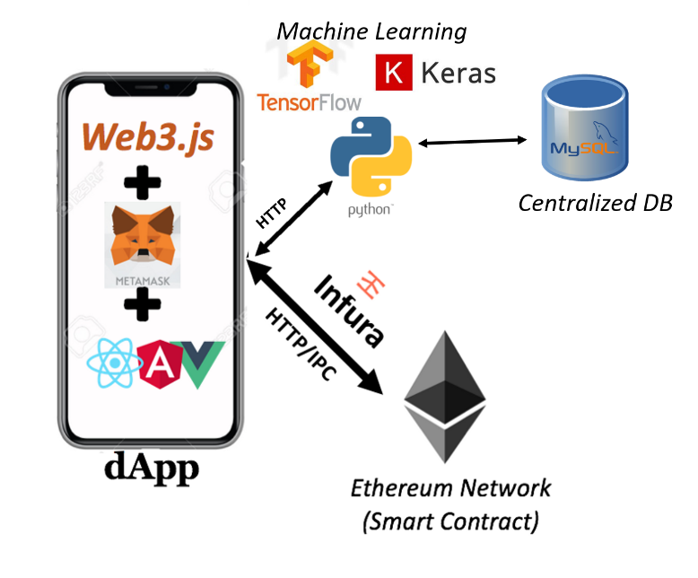
Demonstration of Prototype
(4 min video)
https://www.youtube.com/watch?v=1Y5eyY-KKVw
Please Watch
Idea/Solution :
We are dividing the functionality into two segments, each one powered by Blockchain (Smart Contract).
1. Procurement : Tenders are published by GAIL with requirements. Vendors bid with their bid and quotation. GAIL allots tender to vendor on the basis of requirements met and quotation. State of tender is accessed/updated through Blockchain only, Giving Transparency and Knowledge to Tax payers about how there money is used.
2. Supply Chain : After Tender is allotted, Each step occurring in between Gail and Vendor 1)Shipping, 2)Transportation in intermediary points, 3) Acceptance at GAIL is recorded on Blockchain. This gives as Provenance tracking, Cease the corruption by middlemen, Cost reduction etc. Payment is done only when item is delivered, this increases trust in supply chain.
ML Use cases: 1. To estimate the delivery time 2. To Predict demand i.e. time to order new material
3. Route Optimization: to reduce cost of shipping 4. Supplier selection And supplier relationship management
Technology Stack (All are open source technologies)
Client-Side | Frontend using React.js as framework. MetaMask is a browser extensions that lets you run dApps without being part of the Ethereum network as a Node. (Instead, it lets you connect to another Ethereum Node called Infura) Web3. js is a collection of libraries which allow you to interact with a local or remote ethereum node, using a HTTP or IPC connection.
Blockchain & Server-Side | Ethereum network is accessed through Infura for updating/accessing state of ethereum. We have used MySQL database to store complementary data (to reduce gas cost). We access it using python API hosted on a server. ML libraries used : Tensorflow and Keras
MetaMask
React.js

Slide 3
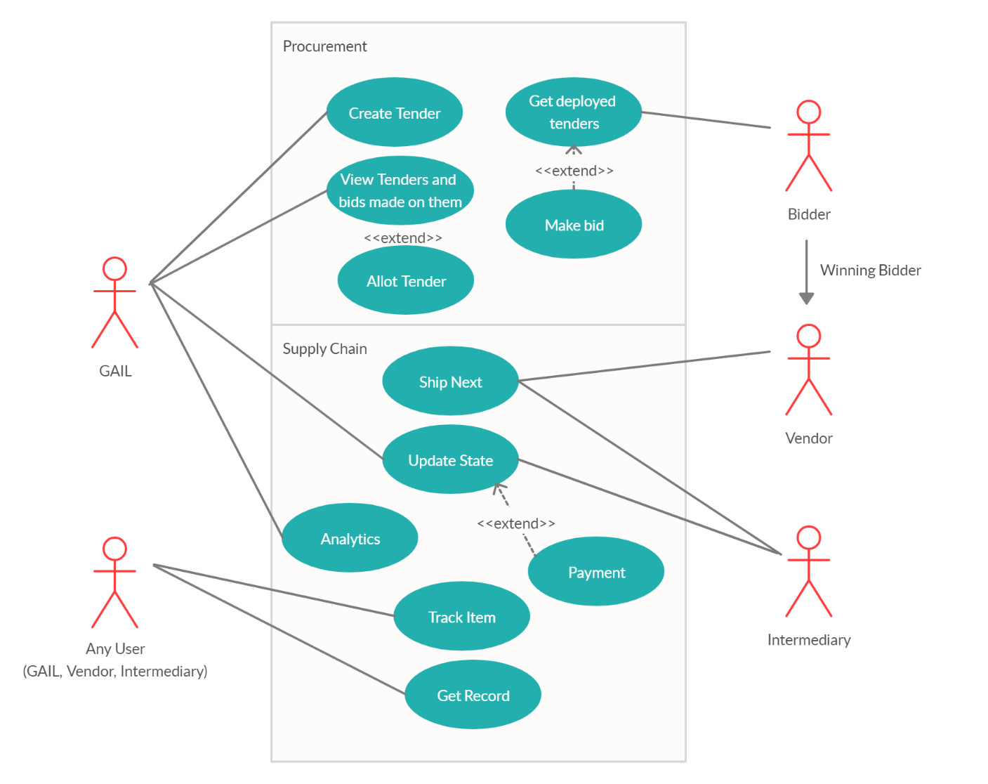
Use Cases:
Procurement
Create Tender | GAIL manager create tender with requirements.
View Tenders and Bids made on them | GAIL manager can view tenders deployed and see bids made on any particular tender.
Allot Tender | GAIL manager allots tender to bidder on the basis of requirements met and quotation.
Get Deployed tenders | Bidder can see created tenders.
Make Bid | Bidder can make bid by adding quotation and his bid.
Supply Chain
Update State | Its used to record that item has arrived.
Ship Next | Its used to ship item to next stop.
Payment | Payment is done automatically when GAIL manager updates state.
Analytics | Contains ML use cases mentioned in previous slide.
Track Item | Used to track current status of item.
Get Record | Used to get complete path of item has gone through.
Show Stopper :
As Mentioned in problem statement, GAIL procures items through foreign vendors too. This Includes Interactions with customs. We would like to get details on this interaction, so we can add it in our dApp.
For ML part currently we are using general dataset. We would like to get real database to specialize model for GAIL.

